Slide 1
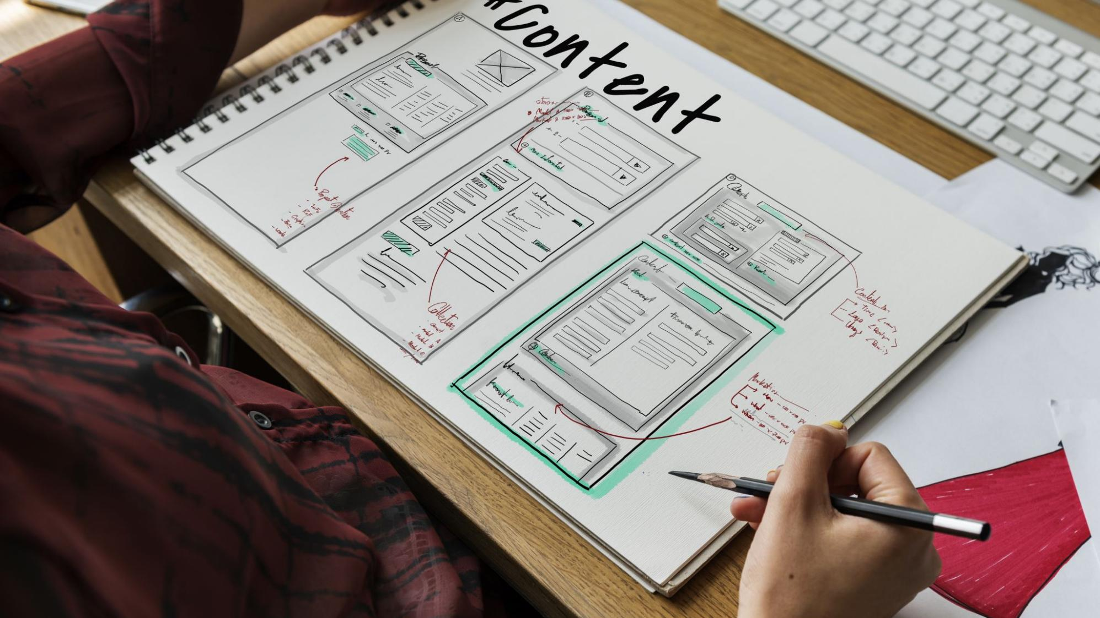
Nevada, MO Comprehensive Plan
Kick-off Meeting

Slide 2

Introductions

Slide 3
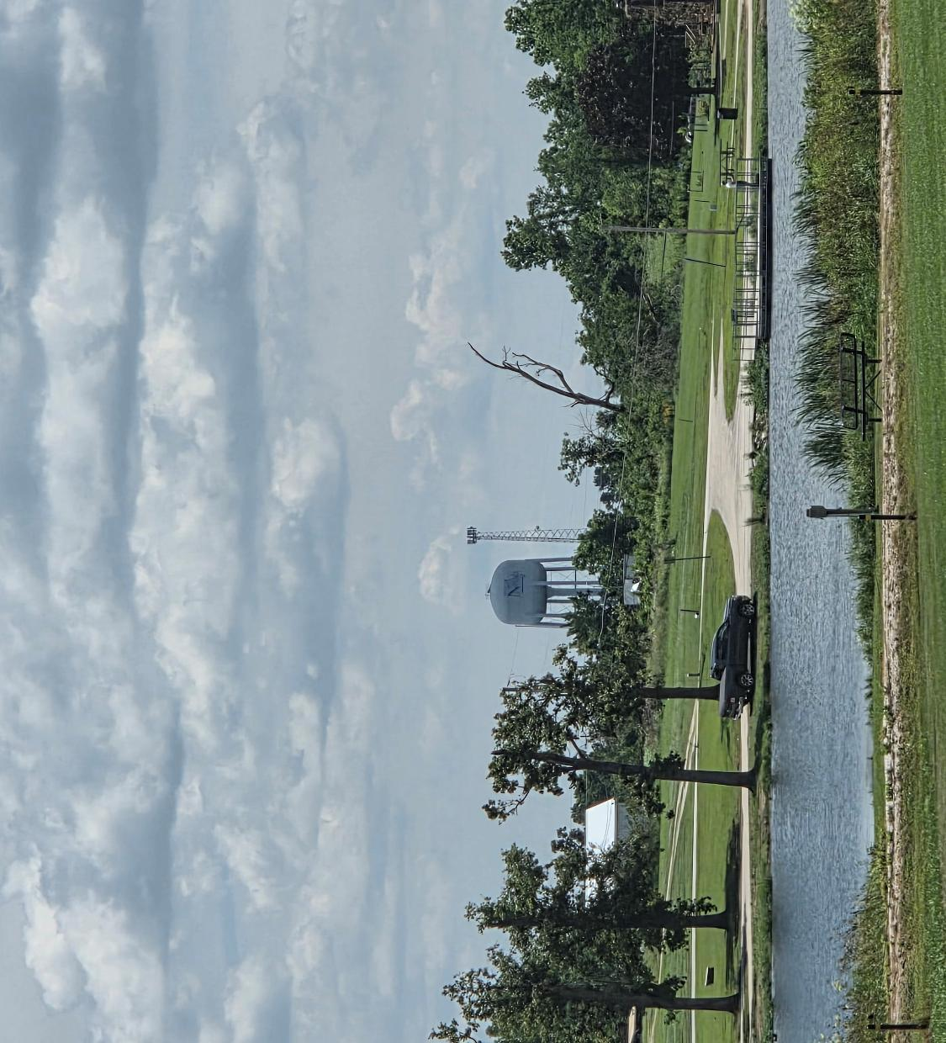
Keith Marvin AICP – Marvin Planning Consultants Ryan Beaver Marvin Planning Consultants

Slide 4
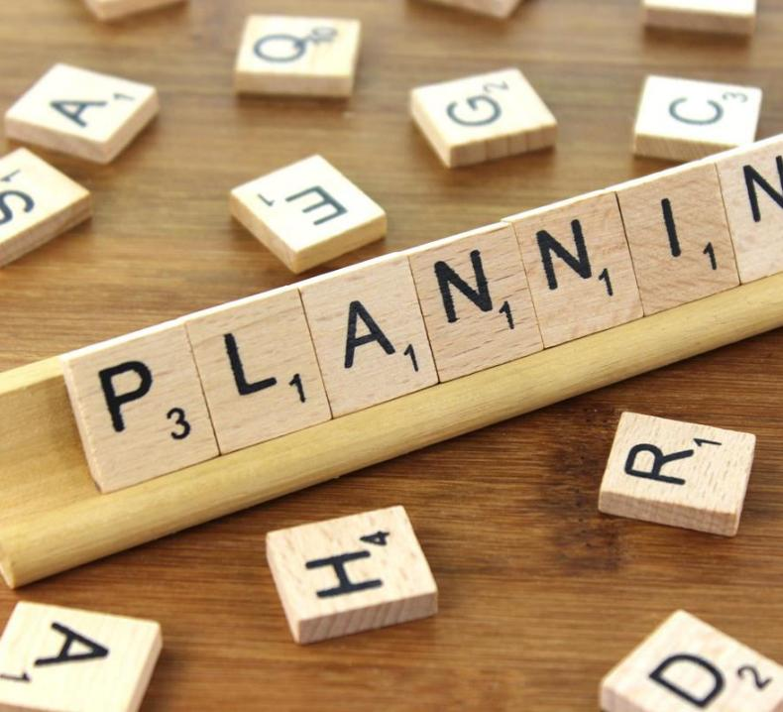
What Is Planning
Planning Is an Organized Way of Determining Community Needs and Setting Goals and Objectives To Address the Needs.
Planning Is A Forward Thinking Process.
This Photo by Unknown Author is licensed under CC BY-SA

Slide 5


What Is Planning
Planning Bridges the Gap from Where We Are To Where We Want To Go.
Planning Is A Process That Can Help Move A Community from Today’s Reality to Tomorrow’s Possibilities.
It is more about the planning than the actual document
This Photo by Unknown Author is licensed under CC BY-SA

Slide 6

What Is Planning
Even a journey of a thousand miles must begin with a single step. Chinese proverb
Never doubt that a small group of committed citizens can change the world; indeed it is the only thing that ever has
Margaret Mead
Vision without action is merely a dream. Action without vision is just passing time. Vision with action can change the world.
Joel Barker

Slide 7

Project Approach

Slide 8

Community Assessment Introduction Community Engagement Population Housing Economics/ Economic Development

Slide 9
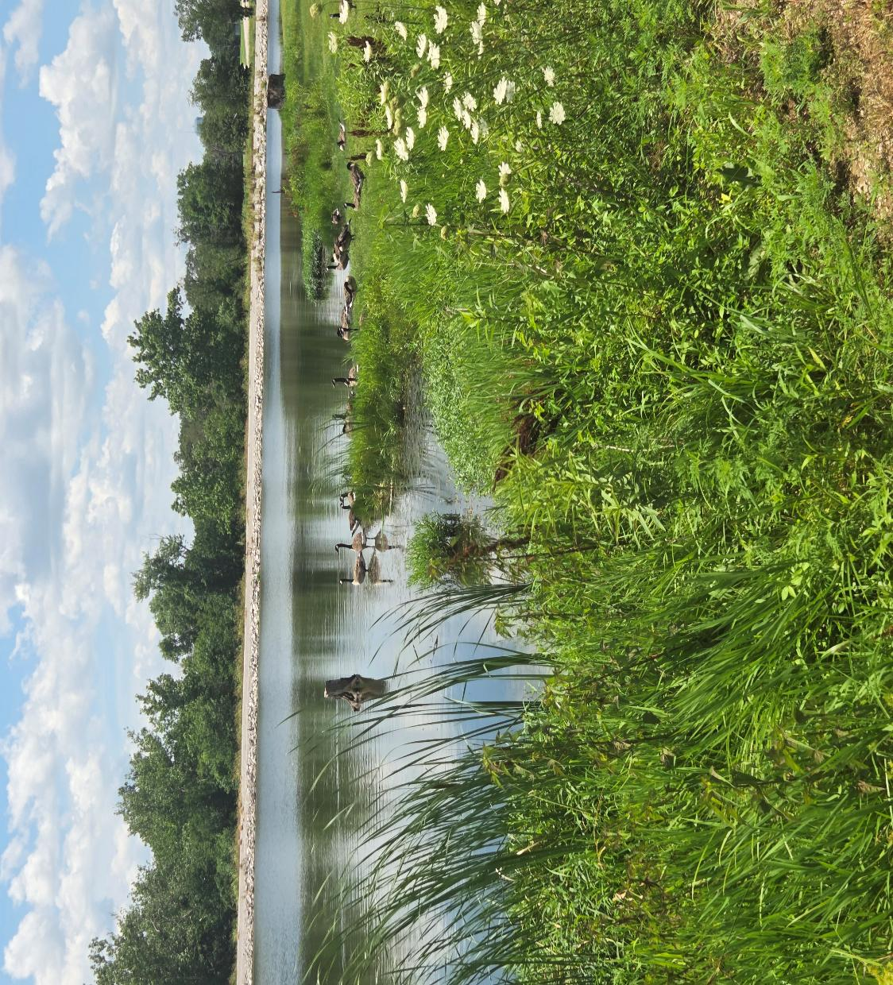
Parks and Recreation City Facilities Public Safety Public Health Telecommunication/Utilities/ Energy Chapter Hazards

Slide 10
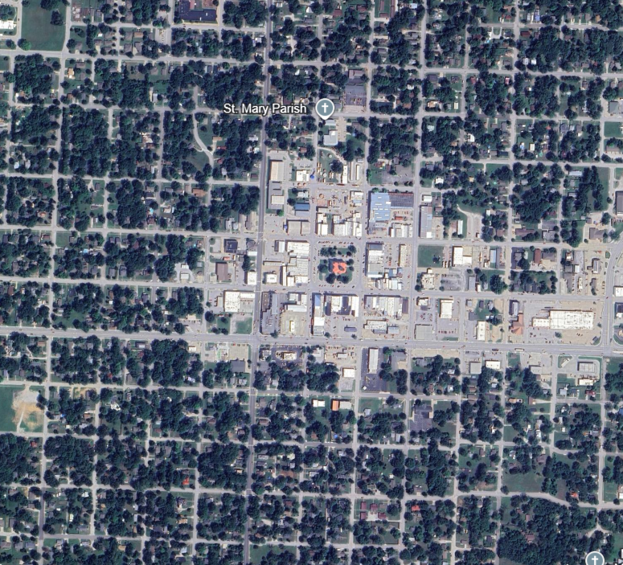
Land Use Transportation Implementation

Slide 11

Introduction

Slide 12
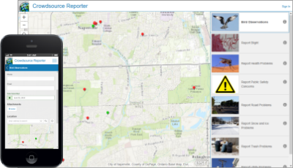


Community Engagement - Digital One crowdsource map for the community One website for the community Promotion through social media Konveio

Slide 13
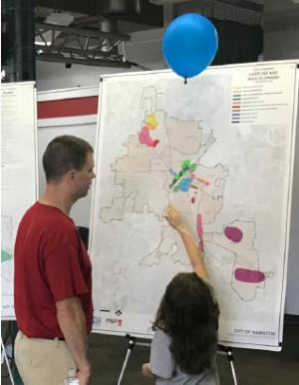
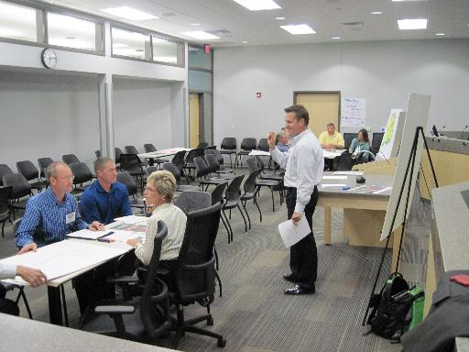
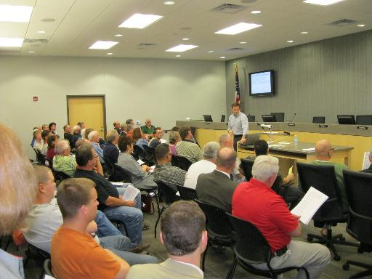
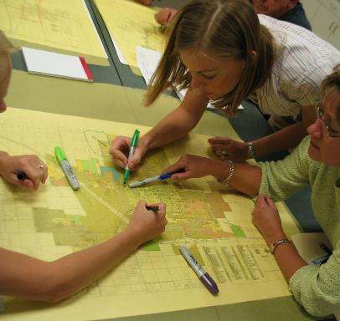
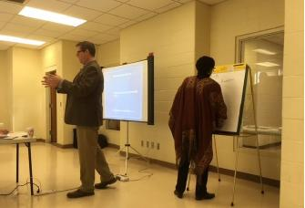
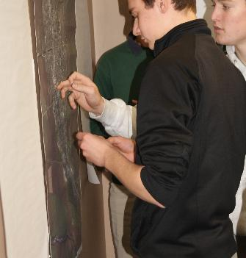
Community Engagement – In Person

Slide 14

Population Population examines the community’s population from various angles: Past populations, Population by ethnicity, Age cohorts, Population change based upon natural and migration patterns, and Population projections based upon past trends, migration patterns

Slide 15

Housing Like the Population Chapter except focused on key housing trends and needs. Key Housing Goals/Objectives/Polices with timeline. Review the housing situation to identify specific needs not being met.

Slide 16
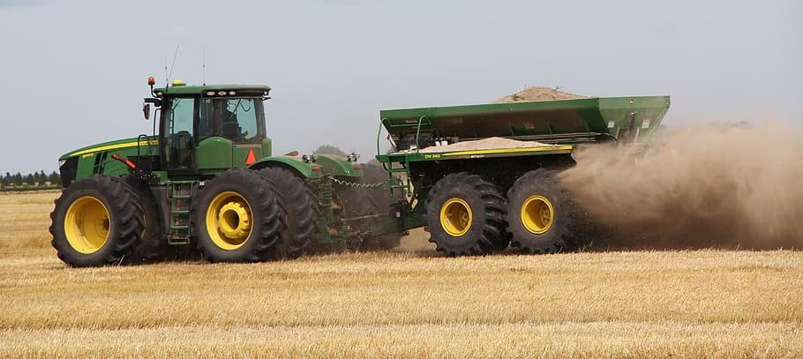
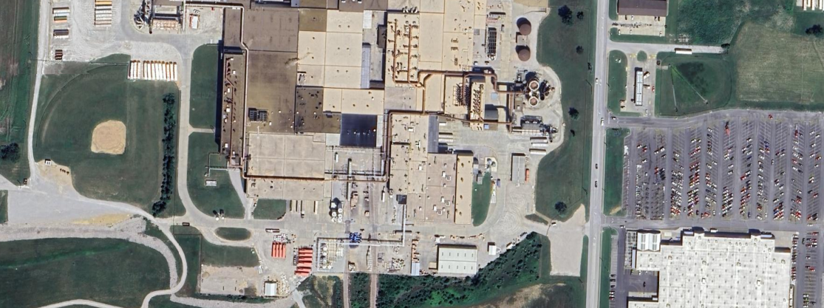
Economics/ Economic Development Examines key economic indicators of the past and present. Painting a picture of the stability of the local economy. Economic development strategies and techniques along with future goals / objectives / policies. Our goals are to provide the community with economic data; plus, Provide potential opportunities so the future land use plan can be finetuned to meet Nevada’s future needs.

Slide 17
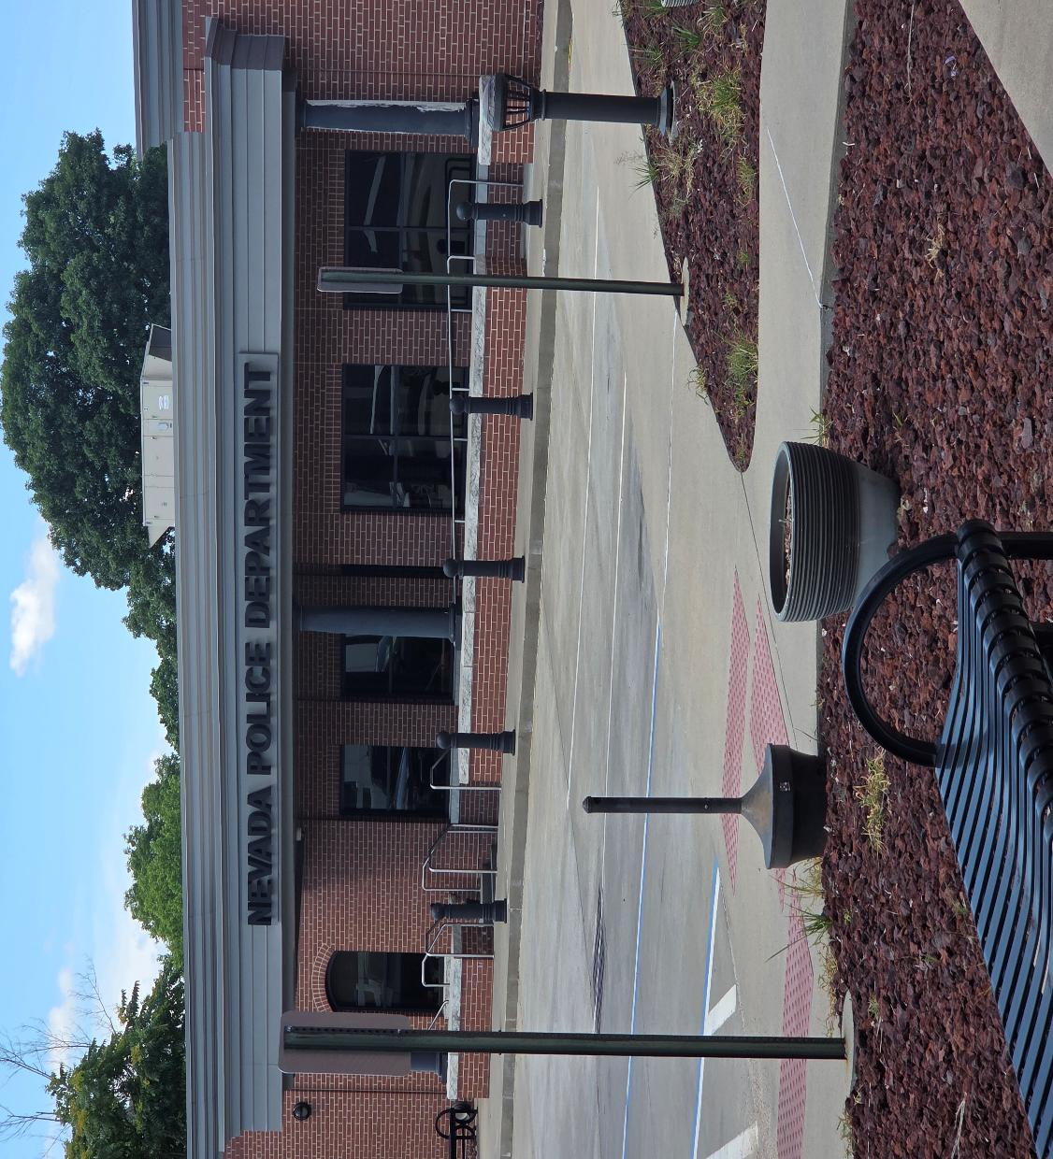
City Facilities Examines key facilities including City facilities and museums, etc. Contain any goals/objectives/polices identified for public facilities. Examine specific levels of service needs and identify areas which may be lacking along with ideas to solve the gaps.

Slide 18


Parks and Recreation Examines the existing parks and recreation facilities available throughout Nevada. Compares the existing facilities and programs to national and regional standards to identify any major shortages or surpluses. The future projections will also be compared to the population projections. Goals/objectives/policies related to parks and recreation.

Slide 19


Public Safety Law enforcement at the city and county level including facilities and locations Fire and rescue facilities and stations. Emergency Management and any other similar public safety component. Goals/objectives/polices identified for public facilities.

Slide 20
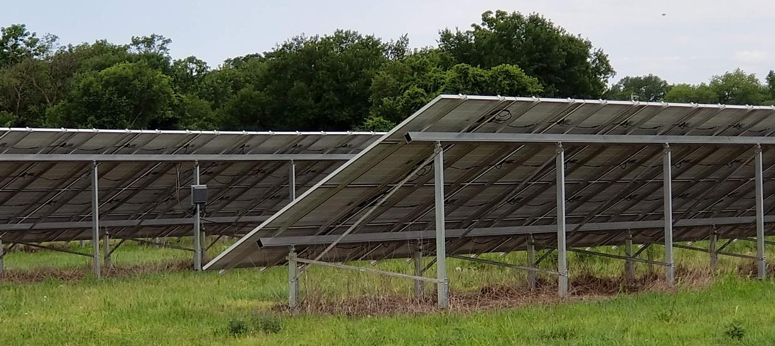

Telecommunications/ Utilities/Energy Examines different means for communication within Nevada and Vernon County (newspaper, television, etc.). Aid significantly in helping to determine future growth areas of the city and county. Examine the different energy sources and needs within Nevada. Goals/objectives/polices identified for public facilities.

Slide 21
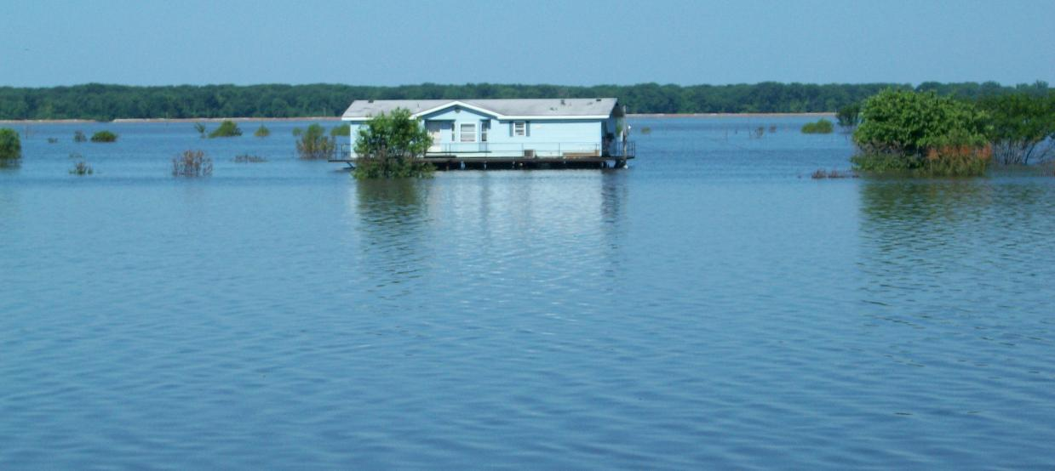
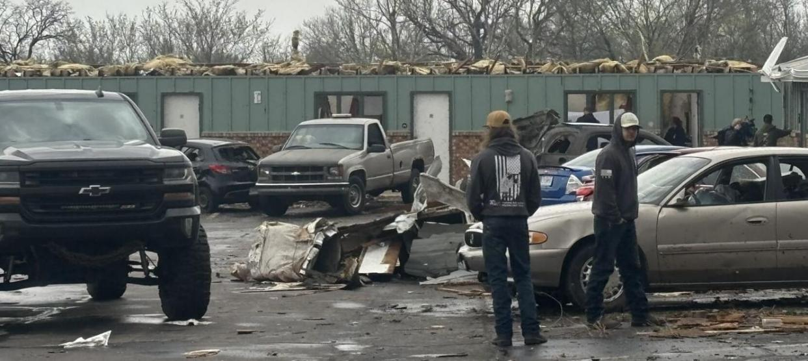
Hazards A reiteration of key goals and policies from most recent Hazard Mitigation Plan (HMP) Allows key policies and projects from the HMP to become apart of the overall planning process. Note: Since most HMPs are updated every five-years, these data will need to be amended in order to stay current.

Slide 22
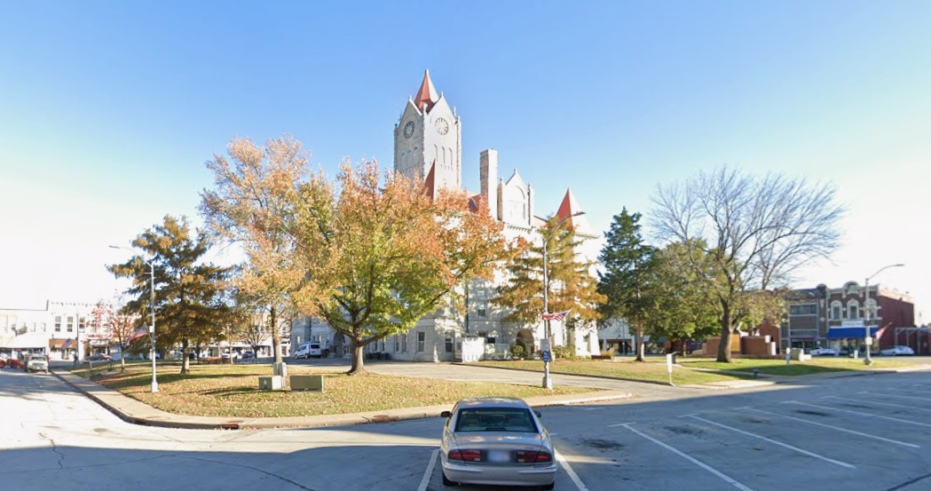
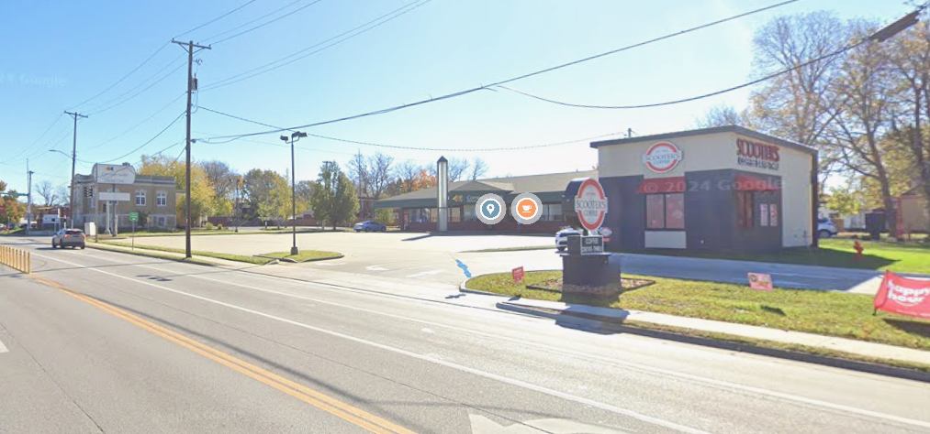
Land Use Land use is a standard Comprehensive Plan element Look at the balance between agriculture and other land uses Land use discussion occurs regarding barriers to future growth, areas in need of redevelopment (may be prioritized) This section very graphic in order to make specific points Key goals/objectives/policies are apart of this section Provide an evaluation of zoning opportunities

Slide 23
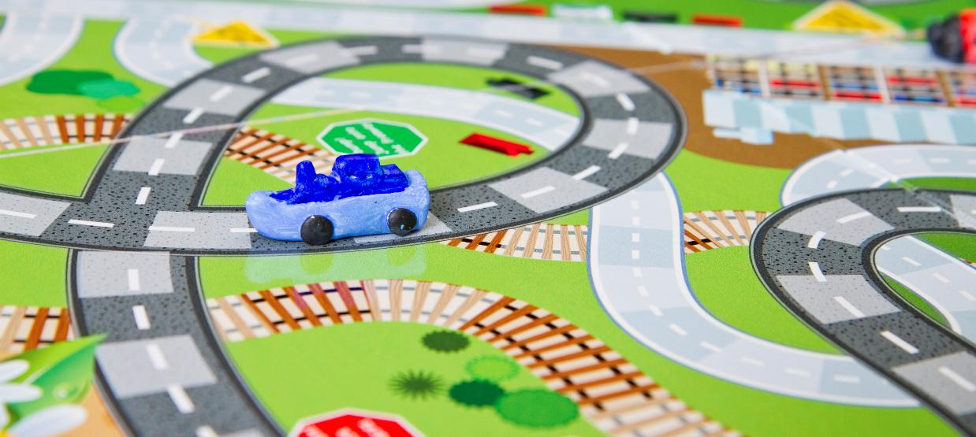

Transportation Transportation is standard Specific policies regarding connectivity and road sharing are typically found within this topic Other issues may be relevant once our team talks with the public works staff Key goals/objectives/policies are apart of this as well

Slide 24

Implementation Implementation, after the goals/objectives/polices are placed in individual sections, becomes a very basic implementation strategy.

Slide 25

Public Involvement

Slide 26


Public Involvement is critical to a successful project Get Involved Be a part of a Focus Group if asked Go to the “In person meetings” in the future Engage on the digital platforms and through our physical surveys

Slide 28

Survey will be topic specific. Take photos of the “good”, the “bad, and the “ugly” in Nevada. Leave photos at the city office if you prefer to show us that way. Use the crowdsource map to show us where there are issues or assets in the city. We will print out 11x17 maps for you to use if you prefer to not engage on a computer.

Slide 29

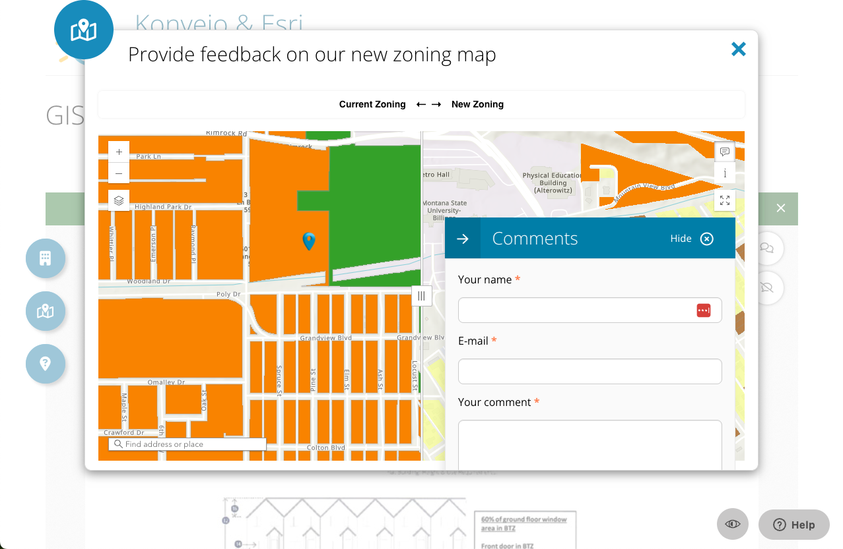

Slide 30
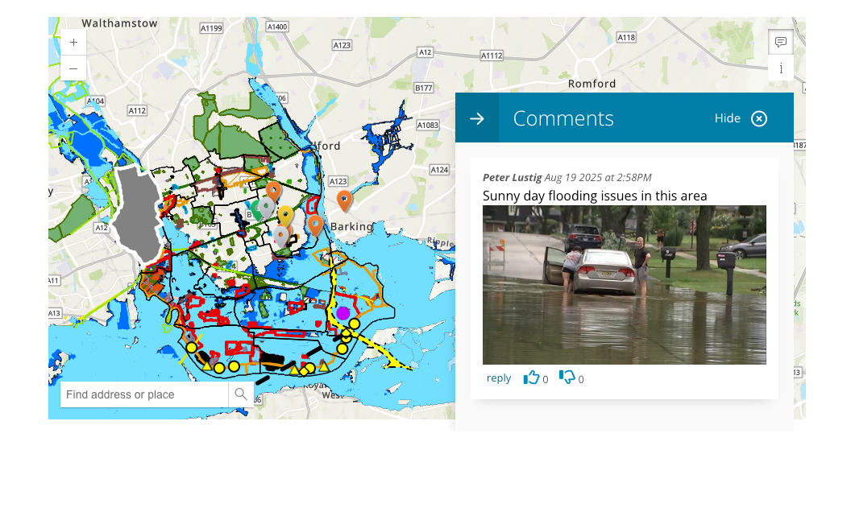

Slide 31


Questions?

